Slide 1
HPU Laboratory Safety
Gary L. Succaw
Howard Payne University

Slide 2
Green Chemistry Considerations
Check over your labs and think about how they could be changed to be more environmental friendly to start.
Example: if benzene is called for, use toluene instead. If you need a grease cutting solvent, can limonene be used instead of hexane or methylene chloride?
Bottomline, if the chemistry can be done with less hazardous or nonhazardous reagents, it should be.

Slide 3

Protective Attire

Slide 4
Required Protective Clothing
All shall wear safety glasses or safety goggles (ANSI Z87.1-2003) while in lab, students and instructors alike. Those wearing glasses must wear goggles over them.
Long pants (no shorts or burmudas)
Socks not anklet type
Closed-toed shoes that cover the entire foot.
No tank tops, and revealing blouses are not allowed. The more skin covered, the better.

Slide 5
Required Protective Clothing
Short sleeves were not specifically forbidden, but either an apron or a long-sleeved lab coat are required to be worn at all times.
Long hair must be put up.
Baggy clothing can be just as dangerous as clothing that is too tight.
Although allowed, student should not wear their warm-up, athletic clothing to lab.

Slide 6
Additional Rules
Enforce all safety rules at all times!
Never allow unauthorized visitors to enter the laboratory (laboratories are not additional office hours).
Never allow students to take chemicals out of the laboratory.
Never leave the students unsupervised.
Never permit smoking, food, beverages, of gum in the laboratory.
Chemical Storage areas are off-limits to all students.

Slide 7




Handling and Storing Reagents

Slide 8
Transporting and Storing Reagents
All chemical reagents should be transported using a secondary containment.
Our plastic carts are acceptable for this, they have a massive secondary containment.
Chemical reagents should be stored in a temperature controlled room away from sunlight and direct heat.

Slide 9
Air Pollution
For volatile, hazardous reagents, a fume hood should be use for the experiment.
Better to replace the hazardous reagent with one not as hazardous.

Slide 10
Air Pollution
Consideration: if a lab calls for 10 mL of benzene, but you only record 5 mL in the hazardous waste container, the rest must have gone into the water stream or evaporated. That’s 5 mL of a carcinogen not accounted for! Better not to use it in the first place.
The labs should be inventoried to find sources of air pollution in addition to emissions from fume hoods.

Slide 11
Flammable Chemicals
No flammable chemicals are allowed to be disposed down the drain.
We should implement a recovery program for ethanol, isopropanol, and acetone to cut down on waste and expenses.
Halogenated and nonhalogenated organics must be placed in separate waste containers. These are not suitable for recovery (not as easy to dry and light sensitive–decompose to hydrogen halides easily).

Slide 12
Flammables
Only store in bottles less than a pint. Otherwise a special dispenser with a self-closing valve must be employed.
Never pour flammables down the drain.
Never allow a flammable solvent to evaporate in the hood. All flammables must be placed in the appropriate waste container.
Only nonhalogenated solvents may be distilled and recycled.

Slide 13
Acids
Acid bottles should be rinsed before handling.
Always add acid to water.
Always add acid to base.
Never put acid waste in with organic waste, especially nitric acid!
Acids and bases should be neutralized to a pH between 6 and 9 (EPA requirements are stricter than local requirements).

Slide 14
Acids
Chromic acid/sulfuric acid baths should not be used. They are allowed, but requires more record-keeping.
Acids should be transported in our rubber containers.

Slide 15
Labels for Secondary Containers
Full Chemical Name, not the formula
Concentration
CAS number(s)
Date Prepared
Hazard Warnings (target organ, brief)
Flinn Family (O 2, I 9, etc.)
National Fire and Safety Info.
Initials of who prepared (not really required by OSHA).

Slide 16
Hazardous Waste

Slide 17
Waste
When choosing a chemical reagent:
Remember that for every dollar spent in the chemical reagent, another dollar should be put aside for its disposal.
Green Chemistry: Waste = Lost Profit

Slide 18
Solid Waste
Most solid waste can go into the regular trash, gloves, paper towels, etc.
However, solids that have been exposed to a hazardous chemical must go into a solid waste container (plastic waste disposal bag) and treated as hazardous waste. No liquid waste is allowed in the disposal bag.
Total suspended solids (TSS) cannot be above 2000 mg/L

Slide 19
Dyes
Dyes that are persistent or hard to break down are not allowed in the waste water.
Not a dye, but potassium permanganate waste should be treated with an acidic sodium bisulfite solution. This will reduce the metal to Mn²⁺ which is not on the regulated list.
Only sufficient bisulfite to reduce the permanganate should be used, excess should be avoided.

Slide 20
Inorganics
Dilution of soluble, hazardous Inorganic salts with sufficient large quantities of water to be in compliance is specifically forbidden by the city of Brownwood and the EPA.

Slide 21
Maximum Allowed in mg/L (ppm)
BOD 2000
Total Suspended Solids 2000
Ammonia 48
Arsenic 0.05
Cadmium 0.34
Chromium (total) 2.75
Copper 0.80
Lead 1.29
Nickel 0.32
Zinc 4.49
Silver 0.38
Mercury¹ 0.000
Cyanide² 0.01
Phenols (total) 87.17
¹ Compliance will be measured at minimum analytical level of 0.2 ug/l (ppb).
² Compliance will be measured at minimum analytical level of 0.2 mg/l (ppm).

Slide 22
Hazardous Waste
All hazardous liquid waste should go into a designated waste container.
Organic Waste
Halogenated Organic Waste
Organometallic Waste
Inorganic Waste (neutral)
All acidic waste should be treated first, then if it has a toxic cation or anion, it should go into the inorganic waste. However, water can be removed by evaporation to reduce the volume, but not organic solvents.

Slide 23
Hazardous Waste
All waste containers should be inspected once a week to looks for any signs of damage, corrosion, dents, cracks, etc.
All waste containers should have a secondary containment to prevent accidental leakage into the sewer system.

Slide 24
Hazardous Waste
Once a waste bottle is filled (should leave several inches of empty space), We are a CESQG class, therefore, we are not required to have a central accumulation site, only satellite sites are available.
As a CESQG, we have a storage limit of 55 Gallons of hazardous waste at the satellite site or 1 quart of acutely hazardous waste.
Best Management Practices are the main requirement for our level of generation.

Slide 25
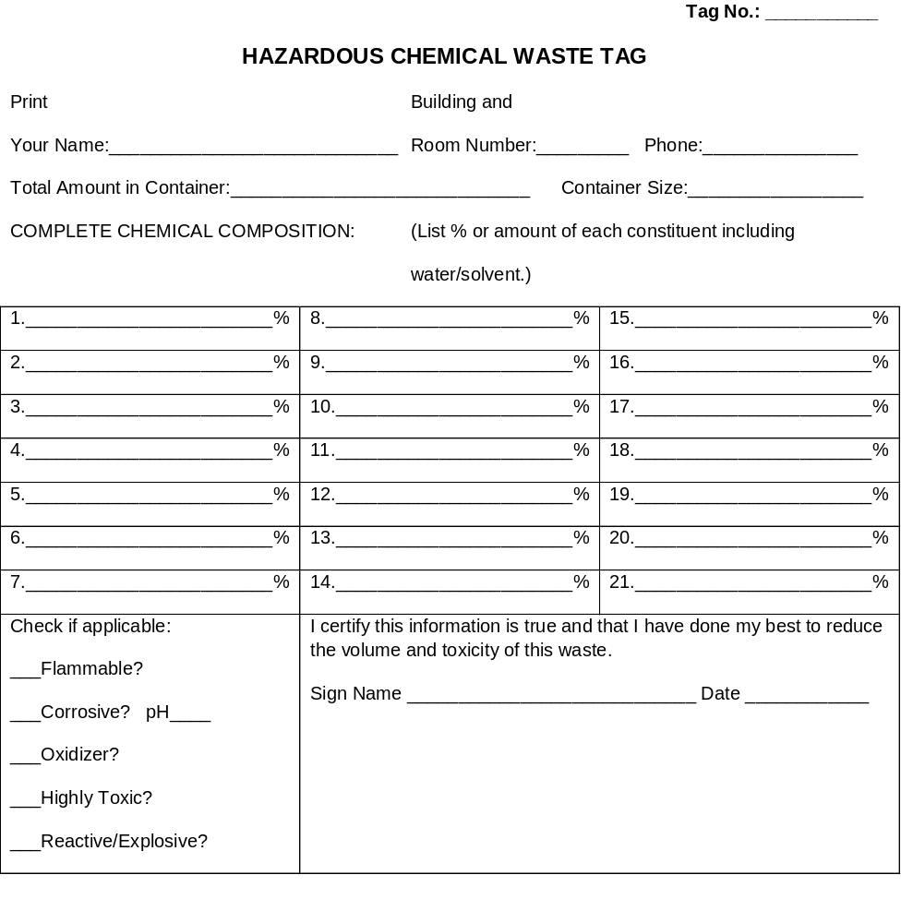
Hazardous Waste Tag
All Waste bottles and bags should have a tag as shown on the right.

Slide 26
Record Keeping
In addition to the hazardous waste tag, a hazardous waste log should be kept with the following:
For Each Waste:
Description of the waste (e.g., waste solvents from labs);
Type of waste (hazardous or acutely hazardous waste);
Hazardous waste class;
Method of characterization (e.g., lab test date, knowledge);
Amount generated in the month; and
Amount accumulated in the month.
Totals:
Amount of all hazardous waste generated in the month;
Amount of all acutely hazardous waste generated in the month; and
Amount of all hazardous waste accumulated in the month.

Slide 27
Avoid the Production of Hazardous Waste
Maintain a limited inventory of chemicals
In the experimental procedure, plan work-up steps that deactivate hazardous waste.
Reuse or recycle spent solvents.
Keep hazardous waste streams segregated. Hazardous from nonhazardous, recyclable from non-recyclable.
Precipitate metals to an insoluble form. Phosphate is a good choice.
Oxidize inorganic sulfides and cyanides.

Slide 28
Spent Oil
The city of Brownwood does not distinguish petroleum based oils from plant or animal based oils. The EPA does, but we have to follow the most restrictive regulations.
Spent oil should be treated as hazardous waste.
Segregating and Recycling spent oil is the best option.
Disposal down the drain is absolutely forbidden under any circumstances.

Slide 29
Batteries
Normal, alkaline batteries manufactured after 1992 can be disposed in the normal trash, but not in large amounts (only two to a container)
Unsealed lead-acid batteries must be recycled.
All other types of batteries must be recycled. Do not dispose in the normal trash.

Slide 30
Radioactive Waste
Avoid using radioactive materials.
Liquid Radioactive waste should be placed into a polyethylene container (less secondary β-radiation than from glass).
Cans should be lined with a yellow plastic bag.
Containers labels should show:
The radionuclide present in the waste.
The dates of accumulation
The lab in which the waste was generated.

Slide 31
Radioactive Waste
A log sheet should contain:
The radionuclide present in the waste.
Amount of activity
User Initials
Disposal Date

Slide 32
Avoiding Radioactive Waste
Using nonradioactive substitutes.
Substituting radioactive materials with shorter half lives.
Do not mix radioactive waste with any other waste!

Slide 33
Accidents
All accidents must be reported and cataloged.
Even if it is a minor cut, it needs to be reported.
Dropping a beaker does not qualify☺

Slide 34
Standard Abbreviations
BOD Biochemical oxygen demand
CFR Code of Federal Regulations
COD Chemical oxygen demand
EPA U.S. Environmental Protection Agency
gpd Gallons per day
mg/L Milligrams per liter
TPDES Texas Pollutant Discharge Elimination System
POTW Publicly owned treatment works
RCRA Resource Conservation and Recovery Act
SIC Standard Industrial Classification
TNRCC Texas Natural Resource Conservation Commission
TSS Total suspended solids
USC United States Code

Slide 35

National Fire Protection Association
Health Hazard (Blue)
4 Danger May be fatal on short exposure. Specialized protective equipment required
3 Warning Corrosive or toxic. Avoid skin contact or inhalation
2 Warning May be harmful if inhaled or absorbed
1 Caution May be irritating
0 No unusual hazard

Slide 36

National Fire Protection Association
Flammability (Red)
4 Danger Flammable gas or extremely flammable liquid
3 Warning Combustible liquid flash point below 100 °F
2 Caution Combustible liquid flash point of 100 to 200 °F
1 Combustible if heated
0 Not combustible

Slide 37

National Fire Protection Association
Reactivity (Yellow)
4 Danger Explosive material at room temperature
3 Danger May be explosive if shocked, heated under confinement, or mixed with water
2 Warning Unstable or may react violently if mixed with water
1 Caution May react if heated or mixed with water but not violently
0 Stable Not reactive when mixed with water

Slide 38

National Fire Protection Association
Special Notice Key (White)
W Water Reactive
OX Oxidizing Agent

Slide 39
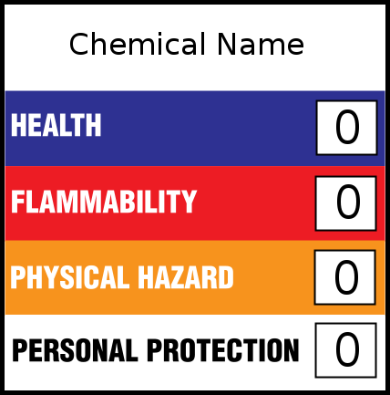
Hazardous Materials Identification System
Similar to NFPA, but different in that these ratings apply to a laboratory situation instead of just in case of a fire.

Slide 40
HMIS Blue
The Health section conveys the health hazards of the material. In the latest version of HMIS, the blue Health bar has two spaces, one for an asterisk and one for a numeric hazard rating. If present, the asterisk signifies a chronic health hazard, meaning that long-term exposure to the material could cause a health problem such as emphysema or kidney damage. According to NPCA, the numeric hazard assessment procedure differs from that used by NFPA.

Slide 41
HMIS Blue
4. Life-threatening, major or permanent damage may result from single or repeated overexposures (e.g., hydrogen cyanide).
3. Major injury likely unless prompt action is taken and medical treatment is given.
2. Temporary or minor injury may occur.
1. Irritation or minor reversible injury possible.
0. No significant risk to health.

Slide 42
HMIS Red
For HMIS I and II, the criteria used to assign numeric values (0 = low hazard to 4 = high hazard) are identical to those used by NFPA. In other words, in this category, the systems are identical. For HMIS III, the flammability criteria are defined according to OSHA standards.

Slide 43
HMIS Red
4. Flammable gases, or very volatile flammable liquids with flash points below 73 °F (23 °C), and boiling points below 100 °F (38 °C). Materials may ignite spontaneously with air (e.g., Propane).
3. Materials capable of ignition under almost all normal temperature conditions. Includes flammable liquids with flash points below 73 °F (23 °C) and boiling points above 100 °F (38 °C), as well as liquids with flash points between 73 °F and 100 °F.
2. Materials which must be moderately heated or exposed to high ambient temperatures before ignition will occur. Includes liquids having a flash point at or above 100 °F (38 °C) but below 200 °F (93 °C) (e.g., Diesel fuel).
1. Materials that must be preheated before ignition will occur. Includes liquids, solids and semi solids having a flash point above 200 °F (e.g., Canola oil).
0. Materials that will not burn (e.g., Water).

Slide 44
HMIS Orange/Yellow
Reactivity hazard are assessed using the OSHA criterion of physical hazard. Seven such hazard classes are recognized: Water Reactives, Organic Peroxides, Explosives, Compressed gases, Pyrophoric materials, Oxidizers, and Unstable Reactives.

Slide 45
HMIS Orange/Yellow
4. Materials that are readily capable of explosive water reaction, detonation or explosive decomposition, polymerization, or self-reaction at normal temperature and pressure
3. Materials that may form explosive mixtures with water and are capable of detonation or explosive reaction in the presence of a strong initiating source. Materials may polymerize, decompose, self-react, or undergo other chemical change at normal temperature and pressure with moderate risk of explosion.
2. Materials that are unstable and may undergo violent chemical changes at normal temperature and pressure with low risk for explosion. Materials may react violently with water or form peroxides upon exposure to air.
1. Materials that are normally stable but can become unstable (self-react) at high temperatures and pressures. Materials may react non-violently with water or undergo hazardous polymerization in the absence of inhibitors.
0. Materials that are normally stable, even under fire conditions, and will not react with water, polymerize, decompose, condense, or self-react. Non-explosives.

Slide 46
HMIS White
This is by far the largest area of difference between the NFPA and HMIS systems. In the NFPA system, the white area is used to convey special hazards whereas HMIS uses the white section to indicate what personal protective equipment (PPE) should be used when working with the material.

Slide 47
HMIS Personal Protection
A
B
C
D

Slide 48
HMIS Personal Protection
E
F
G
H

Slide 49
HMIS Personal Protection
I
J
K
L-Z Site-specific label. Ask your supervisor or safety specialist for handling instructions

